Slide 1
Introduction to SignalR
What you need to know

Slide 2

WHAT WE’LL TALK ABOUT
What’s a (Web)Socket
What exactly is SignalR
Where can it be used
What to use it for
How to use it
Roadblocks you will encounter

Slide 3
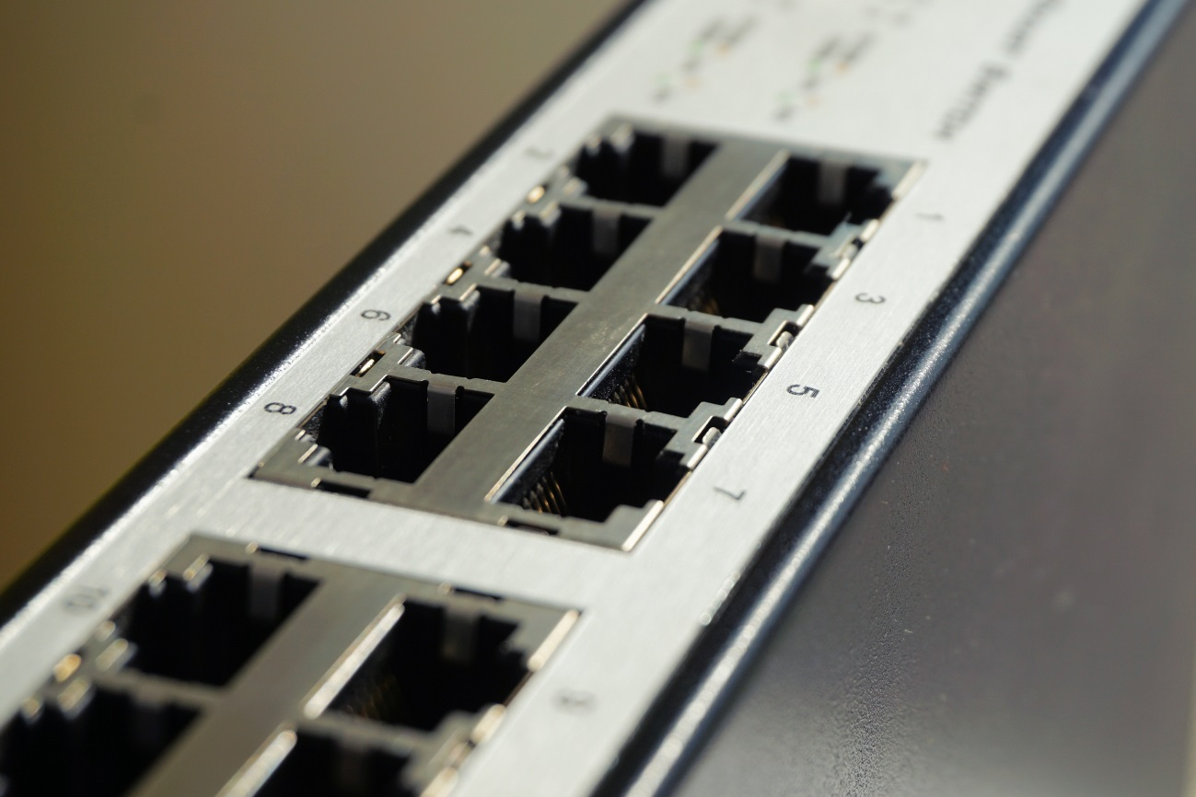
WHATS A SOCKET?

Slide 4
A network socket is an internal endpoint for sending or receiving data within a node on a computer network.

Slide 5
WebSocket is a computer communications protocol, providing full-duplex communication channels over a single TCP connection.
Notes:
WebSocket is a different TCP protocol from HTTP.
Both protocols are located at layer 7 in the OSI model and, as such, depend on TCP at layer 4.
RFC 6455 states that WebSocket "is designed to work over HTTP ports 80 and making it compatible with the HTTP protocol.
WebSocket handshake uses the HTTP Upgrade header to change from the HTTP protocol to the WebSocket protocol.

Slide 6

So…

Slide 7
WHERE?
Server
Client
.NET 4.5+, Core2.1
IIS 8
IIS 7, 7.5 – no WebSockets
Windows – 10, 8, 7
Windows server – 2016, 2012, 2008r2
Browsers
Last 2 versions
Desktop
Windows Store and Mobile apps

Slide 8
WHY?
With
Without
Create Hub implementation
Connect to Hub
DONE
Create a TCPListener and TCPClients
Initialize Network Streams
Interpret Stream Data
Override transport protocol
… Hope this works long-term
Notes:
TCP bullshit - https://developer.mozilla.org/en-US/docs/Web/API/WebSockets_API/Writing_WebSocket_server

Slide 9
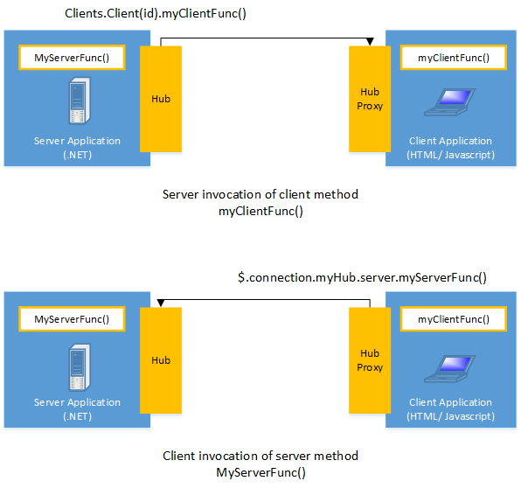

Slide 10
IT’S SMART!
Protocols cascading
WebSockets
ServerSentEvents
ForeverFrame (IE only)
LongPolling
Reconnects… Sometimes, but we can handle that ☺

Slide 11
APPLICATIONS?
Notes:
Games
High performance Real time communication
Push notifications
Etc.

Slide 12
DEMO

Slide 13

http://devbgsignalrdemo.azurewebsites.net/SampleChat.html

Slide 14
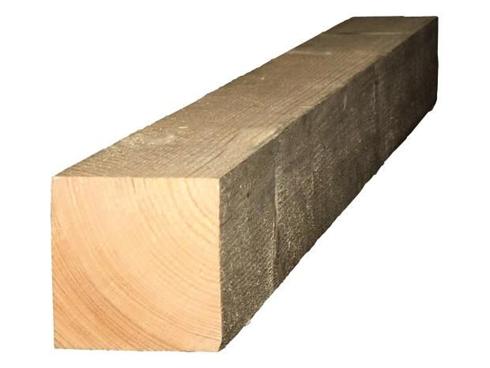
ГРЕДА 1-ва: camelCasing

Slide 15
Server Method
JavaScript call
MyServerMethod(string parameter)
{
// blah blah…
}
connection.myServerMethod(blah);

Slide 16
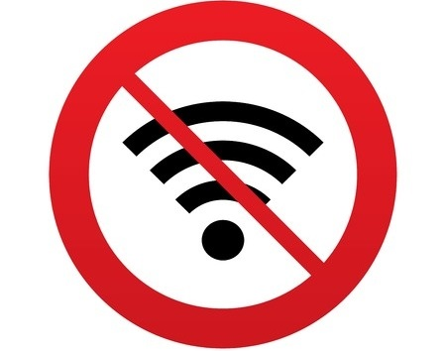
ГРЕДА 2-ра: Connection lost

Slide 17

FIXED!

Slide 18
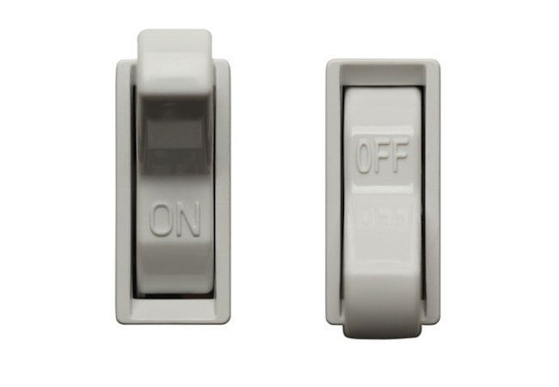
ГРЕДА 3-та: WebSockets not enabled

Slide 19

ГРЕДА 4-та: Connections limit

Slide 20
More than 10 connections?
Upgrade to
Windows Server

Slide 21
WHAT WE LEARNED
What’s a WebSocket
What SignalR is
Supported platforms
Applications
How to start using it
How to handle the most common roadblocks

Slide 22

Questions

Slide 23

Thank you!
Nikolay Vasilev
Co-Founder, SourceWeave
LinkedIn: linkedin.com/in/nikolayvasilev/
Github: github.com/NikolayVasilev/SignalR_DevBG
Others: facebook.com/n.vasilev.fmi
Следващо събитие:
Using MongoDB with ASP.NET MVC

